Slide 1
ECONOMICS AND ECONOMIC STRUCTURE OF SOCIETY
CONFLICTING INTERESTS
DDIFFICULTIES
MISCONCEPTIONS
SALARIES
INTERESTS
PUBLIC POLICIES
RESISTANCE
WELCOME
THE ART OF ECONOMICS CONSISTS NOT ONLY IN LOOKING AT THE CURRENT BUT ALSO THE LONG-TERM EFFECTS OF EACH POLICY AND ACTION. IT CONSISTS OF MONITORING THE CONSEQUENCES THAT SUCH A POLICY HAS NOT ONLY ON ONE GROUP, AND ONE GENERATION, BUT ON ALL GROUPS AND ALL GENERATIONS.
MARKET
PLEASURES
EFFECTS
LOBBIES
OBJECTIVES AND VISIONS
CONSEQUENCES

Slide 2
History of economics.....
Back in the East, 4th century BC, Chinese thinkers, Mencius (the successor of the famous Confucius), dealt with the economic problems of society, the division of labor, the benefit of the rich in relation to the "simple" people.
Homer (8th century BC), who describes the economic problems of the time in the Iliad and Odyssey, the family order of the society in which the aristocrats reign, the core is represented by subsistence production with private possession of land, cattle, slaves, gold..
Xenophon (a pupil of Socrates) advocates for subsistence economy. Economy necessary
for human survival,
brings wellbeing and a great benefit –
It is closely related to politics and military skills.
Households are an integral part of the political community (

Slide 3
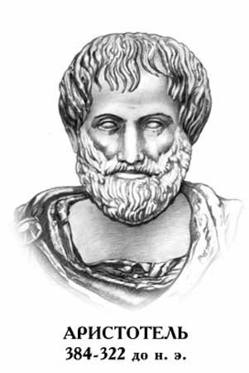
Plato (Greece, a pupil of Socrates, and teacher of Aristotle) is a supporter of the subsistence economy, and opposes private property, believing that virtue and wealth are incompatible. Trade is an unworthy business
Aristotle was the first philosopher economist to be a supporter of commodity production, defining both commodity, value and money because only commodity production and commerce could create such an empire.
The production of goods for the market is natural, but he considered borrowing money as dishonest and unnatural.
Money-gold is firstly the medium of exchange,and secondly treasure that accumulates (he explained the dual role of money).
He was the first one to delineate two properties of goods: the use value and the market value.

Slide 4
The Middle Ages (V-XV century)
The collapse of the Roman Empire, the development of feudalism, - The transition from subsistence to commodity production
Stochastics – medieval theologians
The development of the market raises moral dilemmas, and religious doctrine says that every individual deals morally with others, and this is impaired by the marekt because the logic of "self-interest" appears.
They find a compromise that it is God who has determined each individual's place and role in society.
Martin Luther, founder of Protestantism, in Germany
He advocated for the subsistence economy.
He fought against loan shark and merchant capital.

Slide 5
Mercantilism (XV to XVIII century)
THE CREATION OF THE FIRST SCHOOL OF ECONOMIC THOUGHT, in all Western European countries, it is the time of the flourishing of commercial capitalism (the time of the transition of feudalism to capitalism in the 15th century), the expansion of foreign trade
1. The country's wealth is money.
2. Money is made through foreign trade
3. In foreign trade, exports must be higher than imports.

Slide 6
Physiocracy, XVIII France
They formed the most important economic school – the School of Economists
Physiocracy (fizio -nature, kratos-rule)
The basic starting point is that economic behavior is governed by the law of nature ("droit naturel")
Physiocrats accept enlightened absolutism

Slide 7
CLASSICAL POLITICAL ECONOMY
A set of economic ideas that originate from the parents of the school Adam Smith (“Exploring the Nature and Causes of the Wealth of Nations, 1776)
Economic freedom
Advocacy for a Free Market Match
The natural order, which will correspond to the rationality of homo ekonomikus
Natural order is capitalism, economic philosophy is liberalism and individualism (personal interest above all, and the economic policy of the classical school is liberal – against state intervention

Slide 8
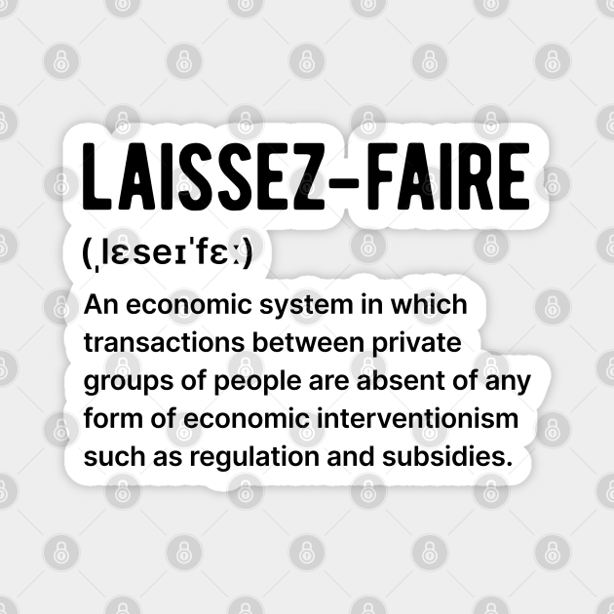
Development of the theory of work value – prices are considered to reflect the social process of production, that is, to reflect the role of work in the production process
Lessez faire order (distrust and hostility towards government intervention)
Ruling by the invisible hand of the market ("invisible hand")

Slide 9
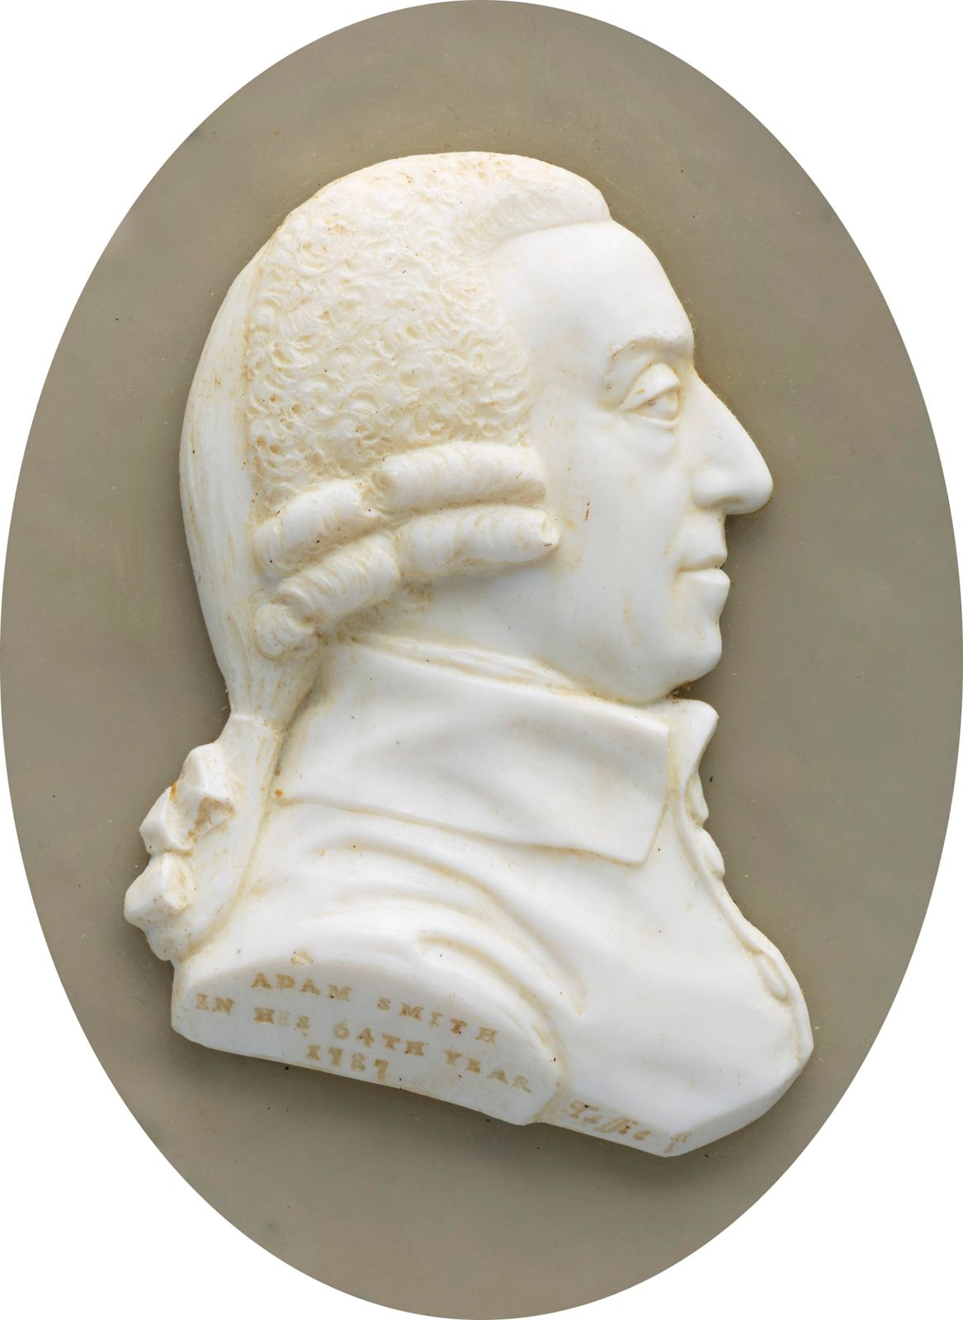
ADAM SMITH – the revolutionary of economic thought
Adam SMITH was born in Scotland in 1723.
Professor of Logic and Moral Philosophy
dedicates himself to writing a magnum opus Inquiry into the Nature and Causes of the Wealth of Nations
In 1776, when the work was first published, it was taken as the year of the emergence of the modern economy.
His general idea is economic freedom.
The topics he dealt with were the natural order, division of labor, the theory of value, distribution, the role of the state in prosperity.
NATURAL ORDER, immanent to human nature, is superior to state and social institutions.

