Slide 1
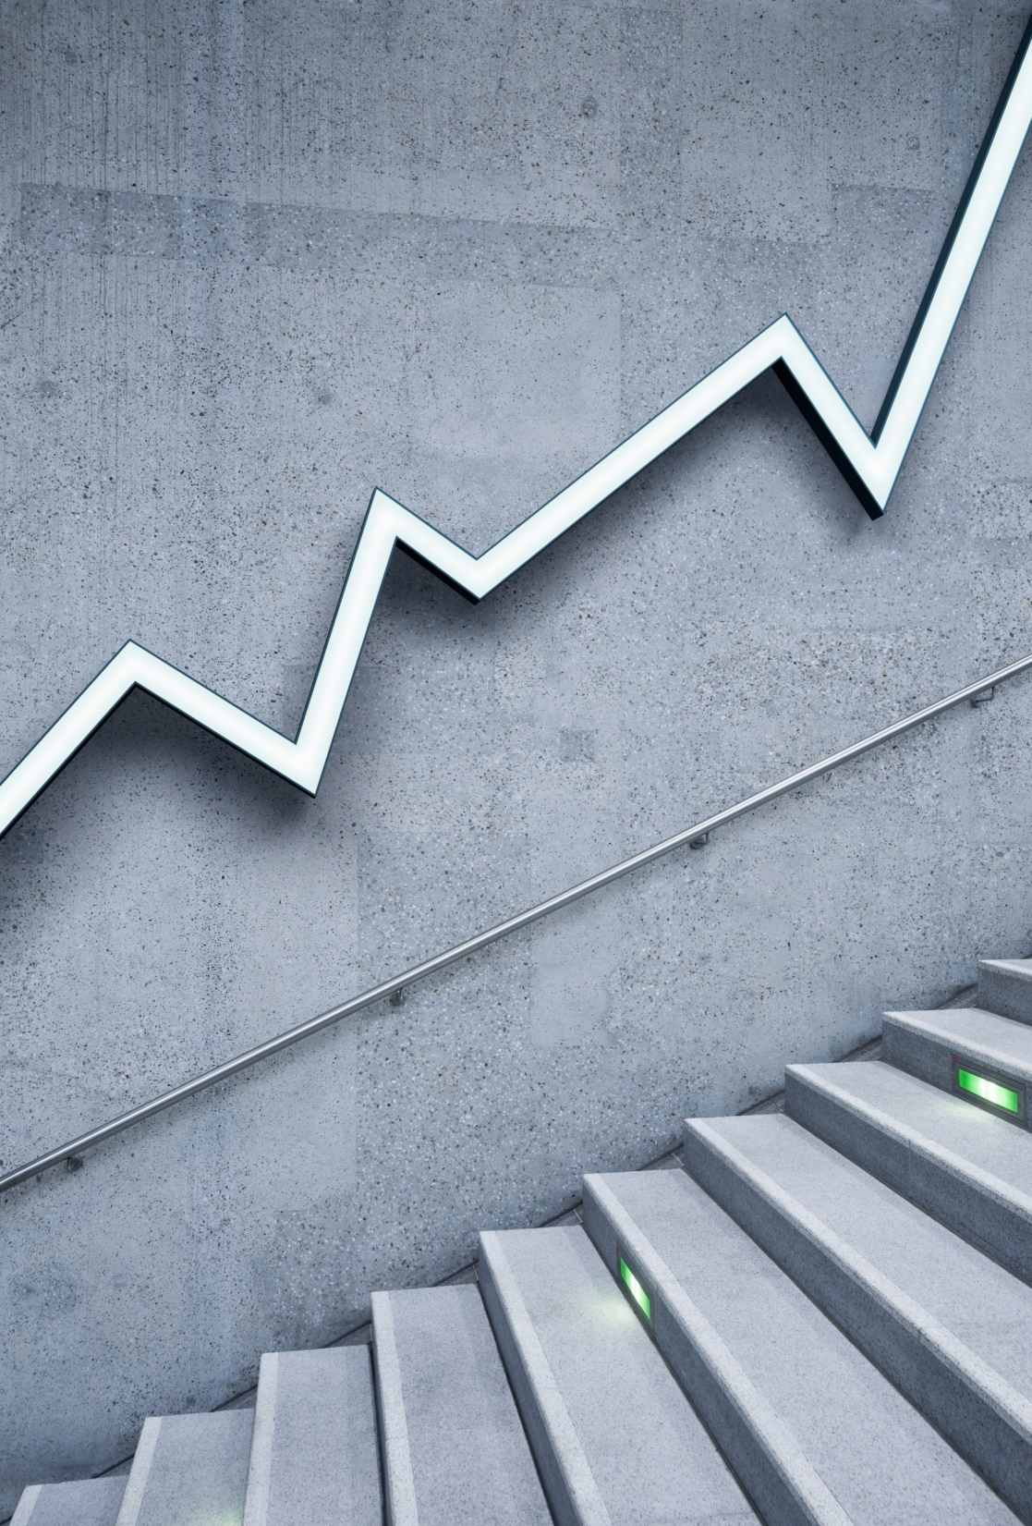
Economics Principles
how do people make decisions?
How do they interact?
How the economy as a whole works

Slide 2
People make choices
There is no “free lunch”.
To get one thing, we have to give up some other thing.
Food versus Clothes
Leisure or work
Efficiency or fairness
Every time we make a decision, it means we give up one goal for another.
Weighing the alternatives:
Scheduling free time

Slide 3
Choice between efficiency and fairness
Efficiency
means that society tends to make the best use of the limited resources at its disposal in satisfying human desires and needs
Fairness
means that the benefits from the efficient use of resources are equally distributed between all members of a society.
The economy produces efficiently when it cannot make one's economic situation better without making another one's economic situation worse.
Notes:
9

Slide 4
The cost of achieving a goal is equal to what we have to give up to achieve it.
Making a decision to carry out any activity requires a comparison of the costs and benefits of that activity and any other alternatives:
Opportunity cost – the cost of a missed chance of a thing is what we have to give up to get that thing
Example: The decision to study:
benefit - intellectual enrichment and the possibility of better employment;
cost - money for tuition, books, rent and food. Time spent studying is a cost (studying instead of employment and earning money)
Opportunities cost is the highest missed profit that could have been made from an activity
Total cost = Actual cost + Opportunity cost (missed profit)
Notes:
10

Slide 5
Rational individuals make decisions on the margins
Marginal changes are additional adjustments to an activity
Comparison of marginal benefit and marginal cost:
An additional hour for studying
Product production (marginal cost and marginal income)
Optimal production volume: marginal income = marginal cost
A rational decision maker assumes an activity only if the marginal benefit from that activity exceeds the marginal cost
Notes:
11

Slide 6
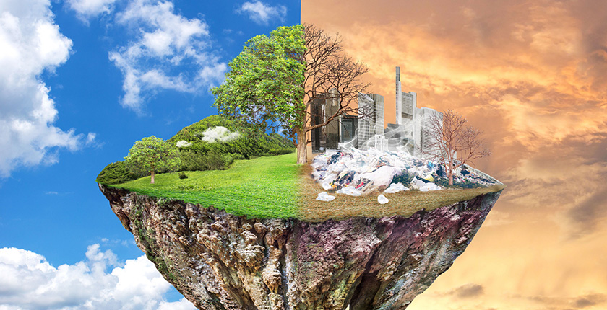
People respond to change/incentives
The decision to choose one alternative over another occurs when the marginal benefits of performing that alternative are greater than the marginal costs!
Impact of price changes on demand and supply of one good
The impact of the increase in the tax on demand and supply of one good
Notes:
12

Slide 7
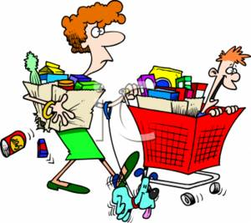
Everyone benefits from trade
Trade between the two countries puts both countries in a better position
Trade allows people to specialize in performing those activities in which they can achieve the best results
Notes:
15

Slide 8
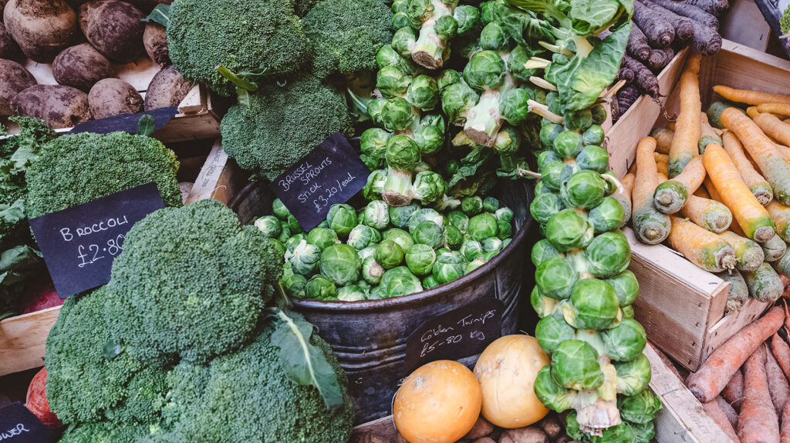
Markets are most often a good way of organizing economic activity
Different economic systems – the economy studies the different mechanisms that society can use to allocate scarce resources
Two basic ways of organization:
The government makes most of the economic decisions.
Decisions are made on the markets.

Slide 9
Principle 7: The state can sometimes improve the functioning of the market
Many would say that if there is an invisible hand of the market and it regulates everything, then why state intervention? The reason is to protect the invisible hand of the market.
The market only works effectively if it is regulated by law.
Every market economy suffers from imperfections that lead to diseases such as excessive pollution, unemployment and the extremes of wealth and poverty.
For this reason, no government in the world should fail to monitor the economy.
Countries have 3 main economic functions in the market economy:
Increasing efficiency
Improving equality - fairness
Strengthening macroeconomic stability and growth

Slide 10
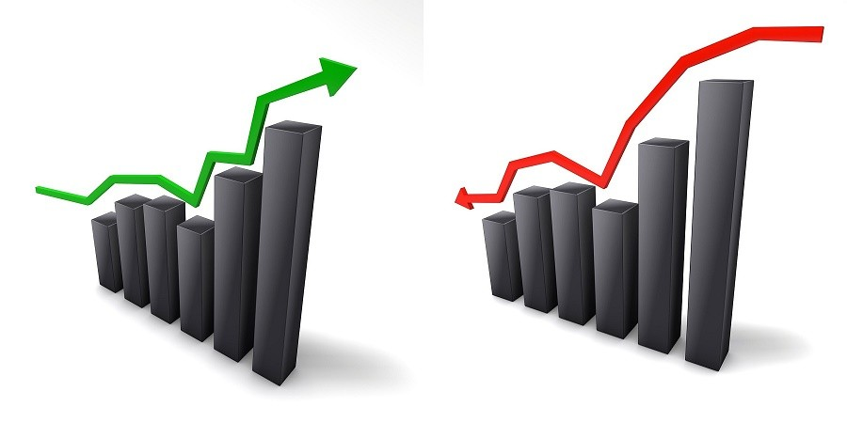
The standard of living of a country depends on its ability to produce goods and services.
The standard of living can be measured in several different ways:
Comparison of personal income
Comparison of the total market value of the national product
Almost all variations in the standard of living between the two countries can be attributed to the difference in productivity of these countries
Notes:
21

Slide 11
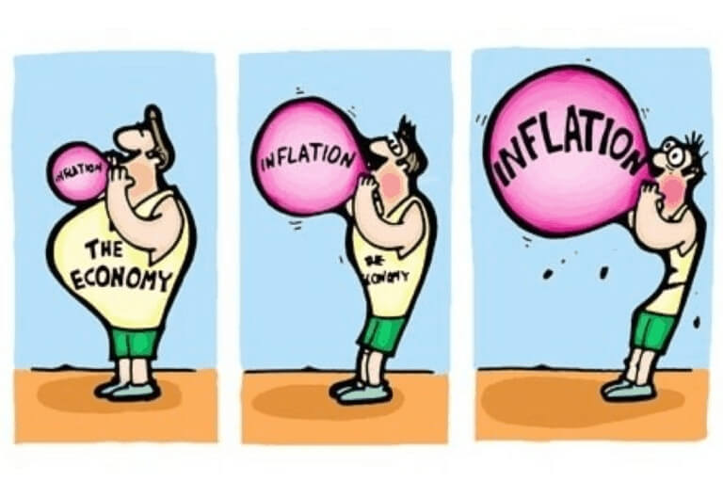
Prices go up when the government prints too much money
Inflation is an increase in the general price level in the economy.
The cause of inflation – an excessive increase in the amount of money in circulation.
Excessive in relation to the increase in the volume of production of goods and services in the economy. –
The state should increase the amount of money in the economy, in proportion to the increase in social production.
In this case: More money in the economy → Greater demand for goods and services (at the same time greater supply of goods and services) → No inflation (i.e. increase in prices).
Notes:
23

Slide 12
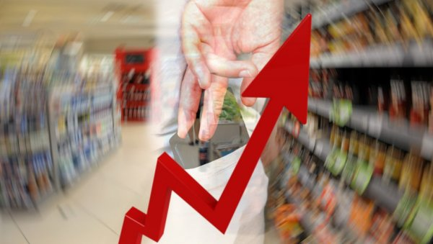
In the short term, the economy is faced with a choice between inflation and unemployment.
The Phillips curve illustrates the short-term choice between inflation and unemployment:
Inflation → Unemployment
It's a short-term choice!
Notes:
24

