Slide 1
Phillips Curve
Inflation? or unemployment?

Slide 2
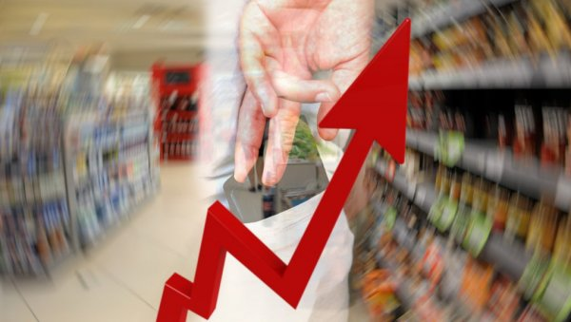
In the short term, the economy is faced with a choice between inflation and unemployment.
The Phillips curve illustrates the short-term choice between inflation and unemployment:
Inflation → Unemployment
It's a short-term choice!
The Keynesian economy has developed a concept of the Philipps curve that shows the relationship between the inflation rate and the unemployment rate.
Notes:
24

Slide 3
Short term choice: inflation or unemployment???
When the government increases the amount of money in circulation, inflation is one of the results of such an action.
The second result, at least in the long term, is a lower unemployment rate.
The curve that illustrates this short-term relationship between inflation and unemployment is called the PHILLIPS CURVE, after the economist who studied this correlation.

Slide 4
Phillips 1958
The modern Phillips curve has replaced wage inflation with price inflation, so it represents an inverse relationship between the unemployment rate and the inflation rate.
Phillips' curve indicates that with the rise of unemployment, there is a decrease in the rate of change in salaries and vice versa

Slide 5
Phillips' Curve - If expected inflation is zero
Low unemployment leads to nominal wage growth
In response to rising wages, companies raise prices.
Responding to rising prices, workers demand higher wages
Higher wages drive price rises again
And so a spiral of wages and prices emerges.

