Slide 1
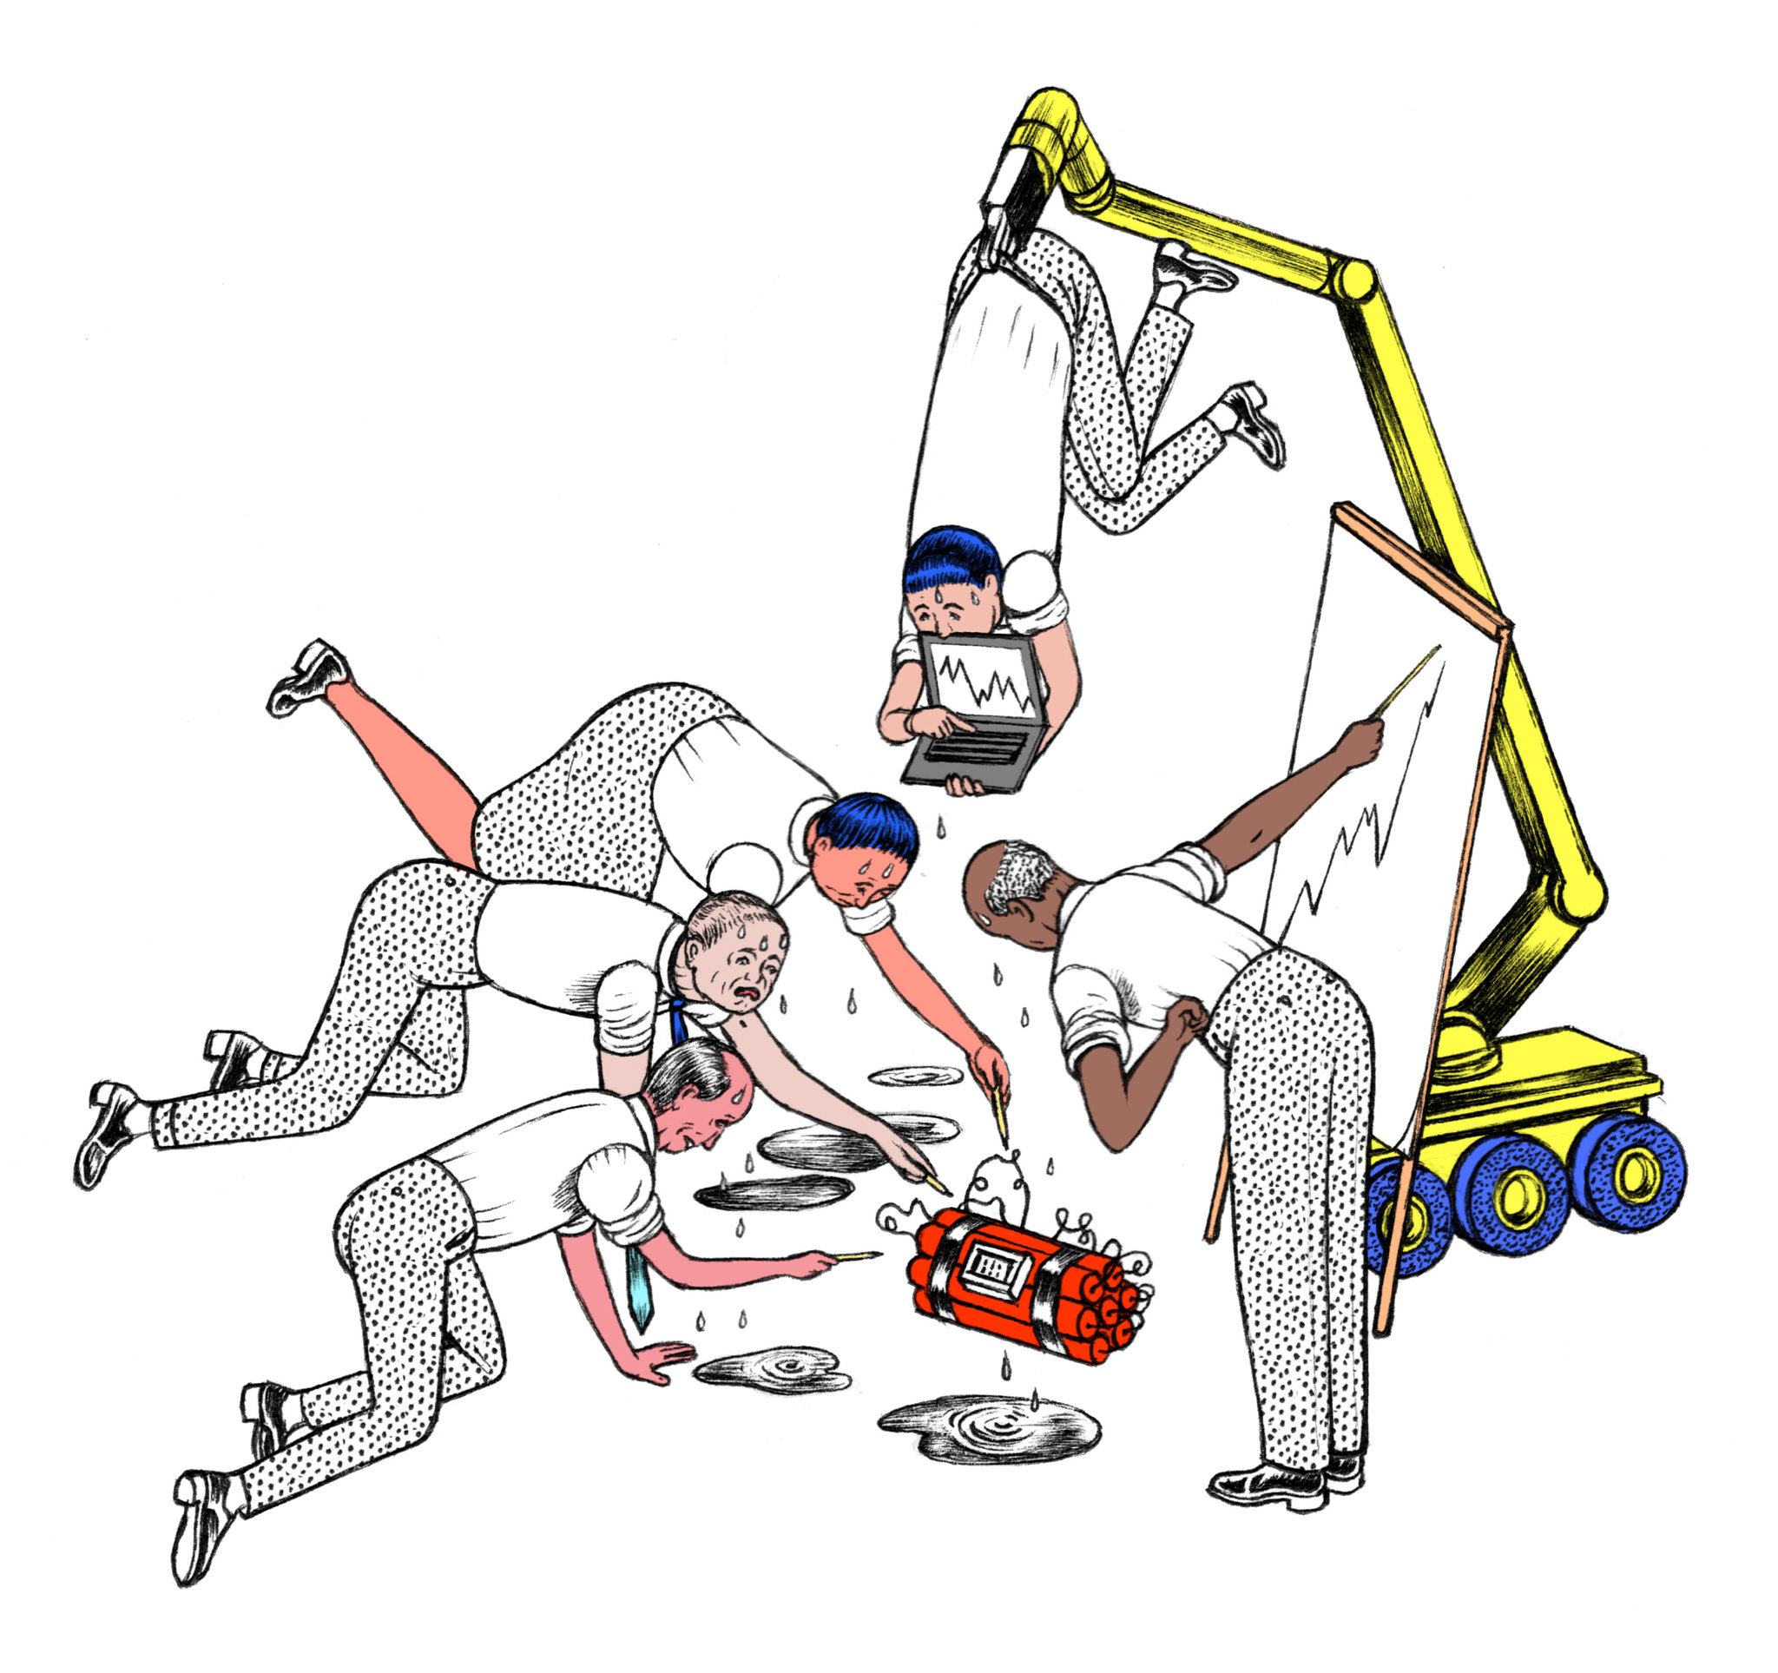
MACROECONOMIC Instruments

Slide 2
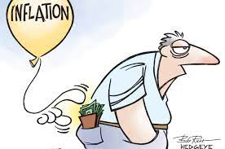
MACROECONOMICS is the science that studies the behavior of society and the economy as a whole.
It studies the forces that simultaneously affect the economy, consumers and workers

Slide 3
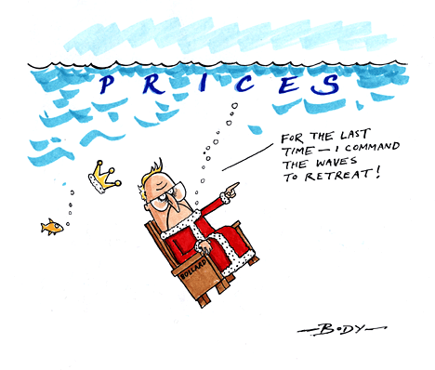
OBJECTIVES OF MACROECONOMICS
PRODUCTION – high level and rapid growth of production
EMPLOYMENT – high level of employment with little involuntary unemployment
PRICE STABILITY
MACROECONOMIC Instruments
FISCAL POLICY - through government spending and taxation
MONETARY POLICY – controlling the money supply in order to determine interest rates

Slide 4
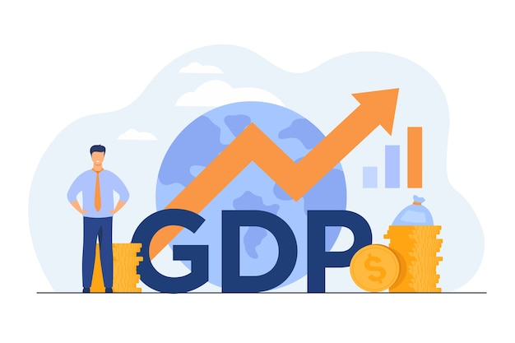
GDP is a measure of the market value of all final goods and services – from beer, cars, rock concerts...- produced in the country in a year.
There are two ways to measure GDP.
Nominal GDP is measured by actual market prices
Real GDP is calculated using constant or unchanged prices, monitoring the pulse of the national economy
Potential GDP is the maximum sustainable amount of production that a national economy can produce –

Slide 5
STRUCTURE OF gross domestic product
Consumption (C)
Investments (I)
Government spending, government purchases (G)
Net exports (NX)
Investments in stocks (SI)

Slide 6
The factors that determine the scope of GDP are:
natural wealth
development of means of production
population
working hours
labour productivity
intensity of work
social relations

Slide 7
Gross national product - GNP
GNP represents the total income earned by the inhabitants of one country (citizens). It covers the income that our citizens earn abroad, and does not include the income that foreign citizens earn in our country.

