Slide 1
PRODUCTIVITY

Slide 2
Principles of reproduction
The principle of productivity, which is expressed in the form of the requirement to produce a certain volume of products and services, with the least possible consumption of labor;
The principle of cost-effectiveness, which is expressed in the form of the requirement to produce a certain value of production, with the lowest possible cost of production elements;
The principle of profitability, which is expressed in the form of the requirement to make as much profit as possible, with as little capital as possible.

Slide 3
Labour productivity
Productivity is the principle of business that achieves the results of the company with minimal investment and consumption of human labor.
It expresses the efficiency of labour consumption in the workflow and business operations of the enterprise.

Slide 4
The general expression of labour productivity is the ratio between the output (Q) and the amount of labour input (R) for that production
P = Q:R
It follows that labor productivity can be increased in two ways:
increase in the amount of performance for the same amount of work invested (i.e. in the same working hours), or
achieving the same amount of impact with less invested work (i.e. in shorter working hours).

Slide 5
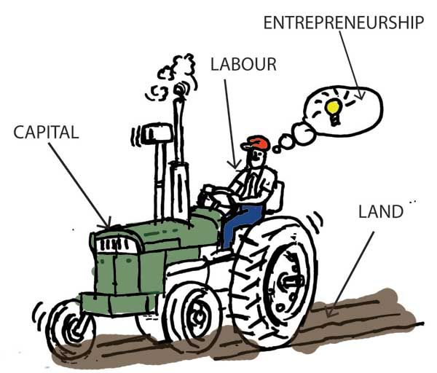
Basic factors of productivity
There are various factors that influence labor productivity. There are many of them, but they are basically the following:
1.Human factor
2. Technical and technological process
3. Organizational factor
4. Social factors
5. Natural Factors

Slide 6
Factors affecting the reduction of work productivity
Additional work the cause of which is found in the product itself
Additional work the cause of which is found in production processes
Additional work due to inadequate organization

