Slide 1
SAVINGS, INVESTMENTS AND CONSUMPTION

Slide 2
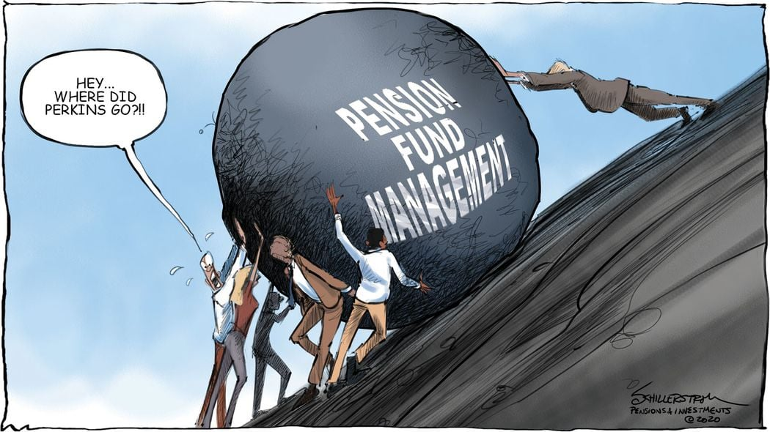
Accumulation - SAVINGS is defined as the process of accumulation, raising capital, funds, in order to maintain the continuity of the production process or as future sources for expanding production.

Slide 3
BI = NI + Iam
BI = gross investment,
NI = net investments (new, expanding investments),
Iam = Renewable Investment .
Macroeconomics is in a state of economic equilibrium if there is an equality of nominal (monetary) accumulation and net investment (A=I)
A>I deflationary gap
A<I inflationary gap

Slide 4
Increase or decrease in investment is influenced by
expected profitability of investments,
costs of acquiring capital equipment,
utilization of production capacities,
technological innovation,
tax policy,
political situation in the country,
international economic relations, etc.

