Slide 1
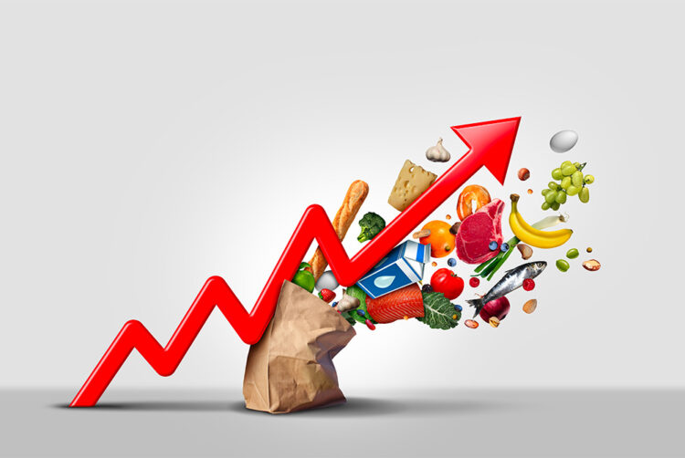
Inflation

Slide 2
The word inflation comes from the Latin word inflatio, which literally means bloating, inflating.
the situation in which due to the increase in the amount of money in circulation there is a decline in the value of the national currency, which is consequently manifested by a general increase in prices.
It is the result of an increase in the amount of money in circulation, without corresponding changes on the supply (production) side.

Slide 3
The causes of inflation are multiple.
With demand inflation, too much spending is diverted to too few commodities.
The reasons are an increase in monetary supply, government expenditures, an increase in exports, which reduces domestic supply.
The rise in nominal wages, the rise in input and energy prices and changes in foreign exchange flows lead to cost inflation.

Slide 4
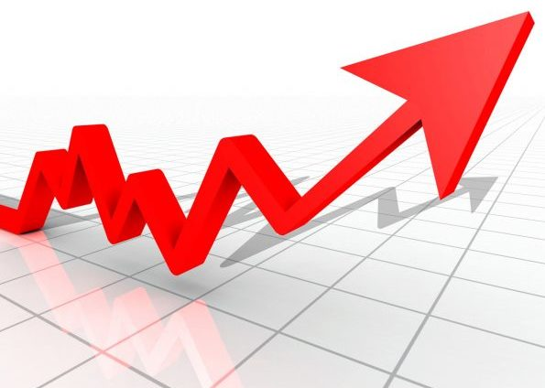
TYPES OF INFLATION
According to the intensity and dynamics, there are:
mild (creeping, latent) inflation,
moderate
galloping and
hyperinflation;
According to the causes, inflation is divided into
inflation of demand
supply inflation;
According to the state of economic activity
stagflation (inflation in a state of stagnation) and
inflation in a state of recession

Slide 5
The effects of inflation are numerous –
increased uncertainty discourages investment and savings.
Income redistribution occurs (deformation of price signals from the market,
there is no incentive and efficiency of doing business.
Inflation brings uncertainty and threatens individual well-being,
misleads all actors

Slide 7
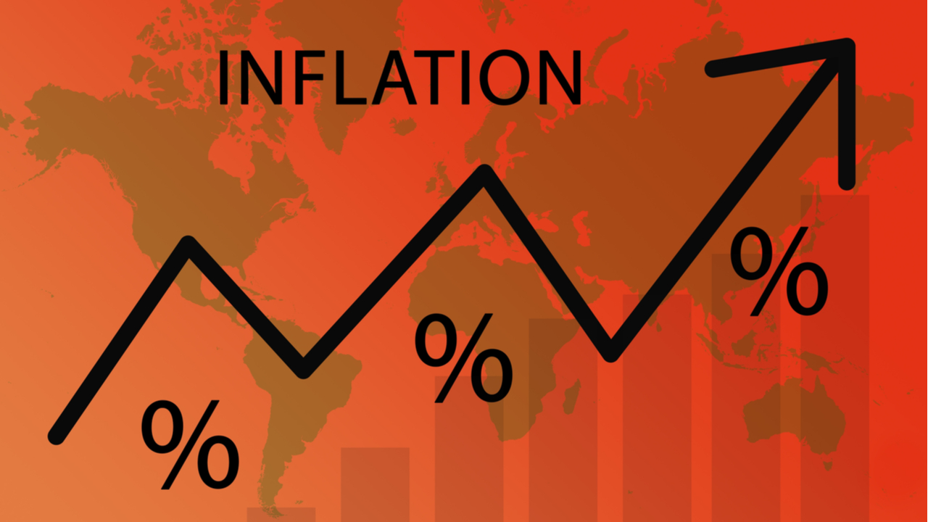
High inflation leads to a loss of people's confidence in the currency and monetary authorities;
it often takes a long period of stability to regain trust.

Slide 8
Inflation by intensity
mild, creeping or latent inflation (up to 5% per year)
moderate inflation (5-10%) implies a slight increase in prices - these are single-digit annual inflation rates.
When prices are relatively stable, people have confidence in money.
People conclude that the value of money will be almost the same in a year, so it is worth keeping it.

Slide 9
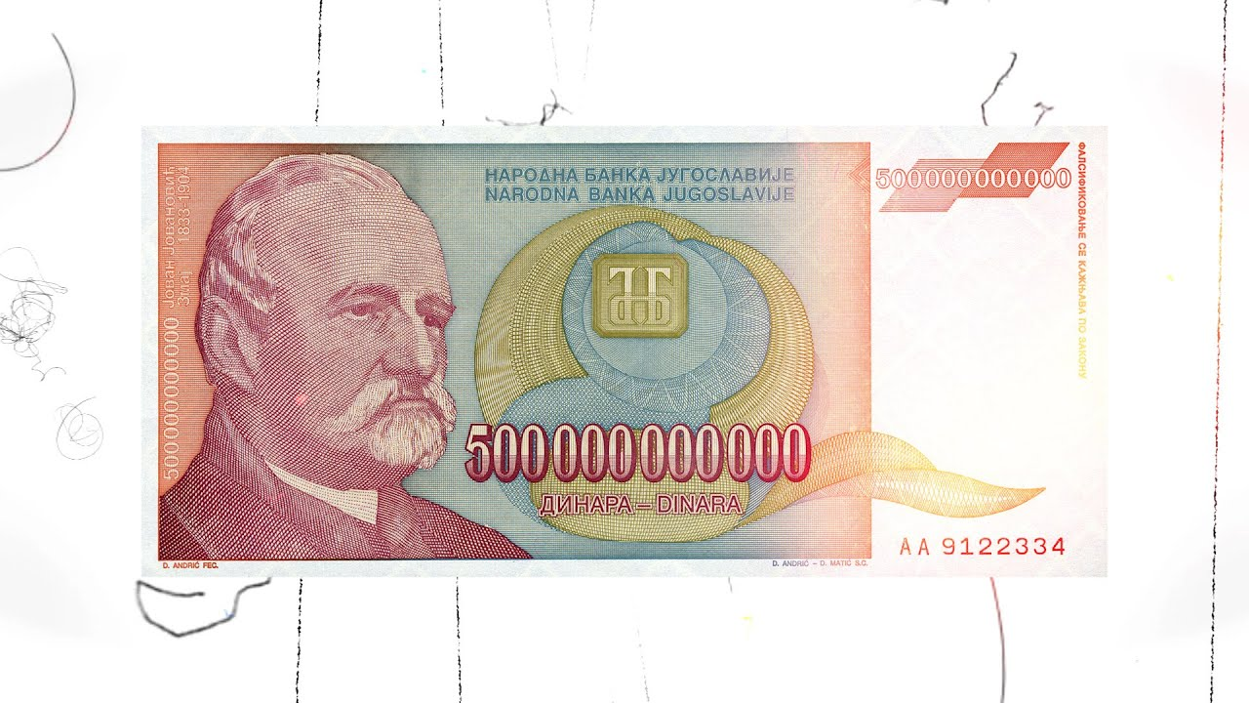
severe or galloping inflation (over 10-100% per year)
In conditions of galloping inflation money very quickly loses its value, this is double or triple inflation, ranging from 20, 100 or 200% per year.
For example, Argentina, Brazil and other Latin American countries had inflation rates of 50-700% per year in the 1970s and 1980s.

Slide 10
hyperinflation (monthly rate over 50% or 1000% per year, breakdown of society)
it is the time of death,
money supply far exceeds its demand.
Money exchange is replaced by barter (commodity exchange), there is a dramatic redistribution of wealth and the economy is in shambles.
Escape from a currency that loses its value,

