Slide 1
COSTS

Slide 2
In each company, we differentiate between
Charges and costs
Wear of production elements is manifested as:
► natural wear and tear
► monetary (financial) type of spending
CHARGES/EXPENDITURES are physically expressed quantities of consumed factors of production in the production process
COSTS are the value-consumption of production elements.
Charges x price = cost
U x Cu = T

Slide 3
Criteria for the division of charges
According to the elements of production
Consumption of materials
Physically expressed quantities of materials consumed in the production process
Expenditures of funds for work
Labour consumption

Slide 4
Costs represent the value expression of the elements of the production process consumed in the company.
Costs of an enterprise are defined as the monetary expression of spending factors of the work process regarding the creation of the effects of the enterprise.
Basic characteristics of costs:
- costs are expressed in value (monetary),
the result of the realized expenditures and their prices and
are directly related to the respective performance (product or service).

Slide 5
COSTS DEPENDING ON THE VOLUME OF PRODUCTION
fixed costs
variable costs

Slide 6
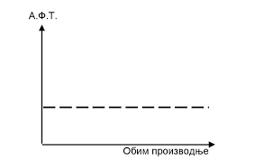
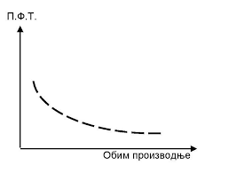
Fixed Costs
masses do not change with the change in production volume (OP)
per unit of product are reduced with increasing production volume
Total Fixed Costs
Average Fixed Costs

Slide 7
Variable costs
change with the change in production volume
total variable costs increase with increasing production volume, and with decreasing production volume they decrease
per unit of product they do not change

Slide 8
The total cost curve is derived vertically by summarizing the total fixed cost curve (UFT) and the total variable cost curve (UVT)
UT = UFT + UVT
The UT curve never starts from zero, but from the amount of fixed costs, because even when the production volume is zero, UT = UFT
The average total cost of PUT is the total cost per unit of product
Calculated when Total Cost is divided by the number of products
Average total costs show the amount of total costs per unit of product
PUT = PFT + PVT
Example
Ut = 9200 dinars
Q = 10 products
PUT = 950 din (9200/10)

