Slide 1
MARKET

Slide 2
The market is also a means to valorize and "test" the effects of a certain macroeconomic policy, in RELATION to:
producer-consumer;
consumer-state;
producer-state;
producer - producer

Slide 3
The market is a mechanism by which buyers and sellers are connected in order to exchange goods and services
Subject of exchange on the market:
Goods and services
Production factors (labour, capital and country)
Financial Instruments
Types of markets
According to the subject of exchange:
Market for goods and services
2. Production Factor Market
3. Financial market
According to the location:
Local market
2. Regional market 3. National market
4. International market
5. World Market
According to the degree of freedom:
Open
2. Closed market

Slide 4
Market Functions
Basic function:
linking production and consumption
Other functions:
Information function of the market
Selective function of the market
Allocative function of the market
Distribution function of the market

Slide 5
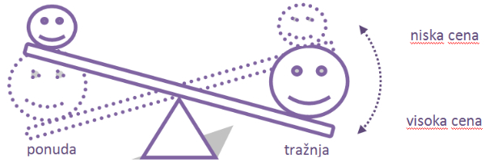
Demand holders customers (consumers)
Supply holders sellers (manufacturers)
Offer: ratio of production costs to price
Demand: the ratio of the benefits of use and price
Balance price: quantities offered = quantities requested
The justification of economic decisions is confirmed on the market (risk)

Slide 6
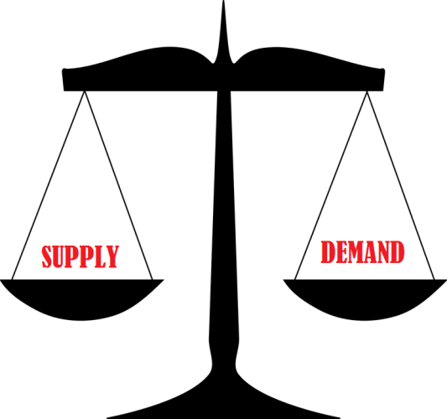
OFFER
The offer implies the quantity of some goods or services (or other goods) that a particular entity at its disposal is willing to sell at an appropriate price.
The offer is the ratio of the quantity of goods offered on the market and its price.
It also expresses the manufacturer's sales readiness (potential offer) at different price levels and other market conditions.

Slide 7
The market structure can be in the form of
Total competition
Monopoly
Monopolistic competition
Oligopoly

