Slide 1
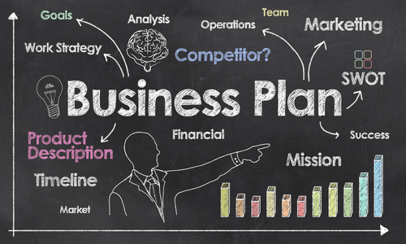
BUSINESS PLAN
A GOAL WITHOUT A PLAN IS JUST A WISH

Slide 2
It represents a study containing the basic elements of a business venture which enables potential investors and financiers to consider the presented venture more quickly and to make easier decisions about possible financing, i.e. participation in the realization of the financing

Slide 3
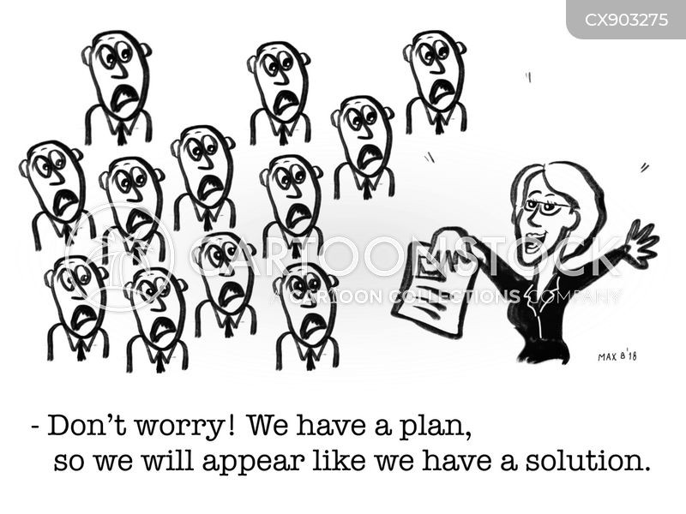
BUSINESS PLAN
The form and content of a business plan varies depending on the type of activity of the company and the purpose of the business plan.

Slide 4
the basic elements of the business plan are as follows:
Introduction
Abstract
basic information about the company;
a description of the company's activities;
development strategy;
the investment project to be financed;
financial indicators with business projections in the future.

Slide 5
The basic characteristics of the business plan are: comprehensibility, relevance, caution and reliability.
Understandability implies that the information in the business plan is understandable to users.
Relevance means that the business plan contains information that is important for the business and making business decisions.
Caution means that the principle of restraint is used,
Reliability is the requirement that the projection be made on the basis of credible information.

